Slide 1
Liberating Principles
What is Possible When Liberating Structures Are Part of Everyday Interactions
How we behave when we decide that we belong together
Notes:
Can be used after LS experiences to illuminate “what is made possible with everyday use” and the assumptions underneath the LS repertoire.

Slide 2
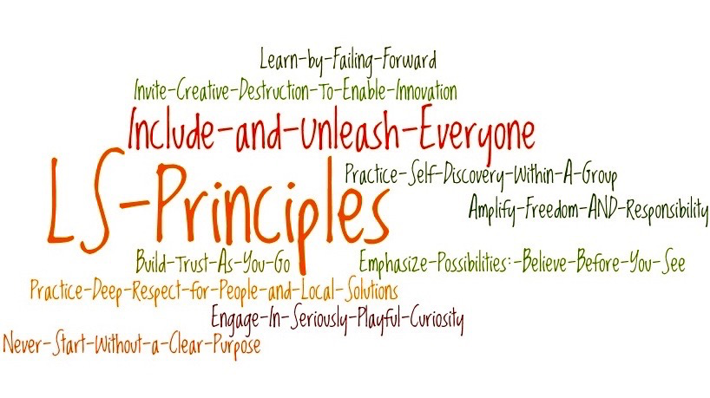

Slide 3
1. Include and Unleash Everyone
Must Do’s (start and amplify)
Must Not Do’s (stop and reduce)
Invite everyone touched by a challenge to share possible solutions or invent new approaches together.
Actively reach across levels, beyond the usual suspects.
Appoint a few to design an “elegant solution” and then tell all others to implement it after the fact.
Confront resistance with hours of PPT presentations. Force buy-in. Separate deciders from doers.

Slide 4
2. Never Start Without A Clear Purpose
Must Do’s (start and amplify)
Must Not Do’s (stop and reduce)
Dig deep for what is important and meaningful to you and to others.
Take time to include everyone in crafting an unambiguous statement of the deepest need for your work.
Maintain ambiguity by using jargon.
Substitute a safe short-term goal or means-to-an-end for a bold reason to exist or deep need.
Impose your purpose on others.

Slide 5
3. Practice Deep Respect for People and Local Solutions
Must Do’s (start and amplify)
Must Not Do’s (stop and reduce)
Engage people doing the work & familiar with the local context.
Trust and unleash their collective expertise and inventiveness to solve complex challenges.
Let go of the compulsion to control.
Import best practices, drive buy-in, or assume people need more training.
Privilege experts and computer systems over local people and know-how.

Slide 6
4. Build Trust As You Go
Must Do’s (start and amplify)
Must Not Do’s (stop and reduce)
Cultivate a trusting group climate where speaking the truth is valued and shared ownership is the goal.
Sift ideas & make decisions using input from everyone.
Practice “nothing about me without me.”
Be a leader and a follower.
Over-help or over-control the work of others.
Praise and pretend to follow the ideas of colleagues.
Indirectly, respond to ideas from others with cynicism, ridicule, criticism, or punishment.

Slide 7
5. Learn by Failing Forward
Must Do’s (start and amplify)
Must Not Do’s (stop and reduce)
Debrief every step.
Make it safe to speak up.
Discover positive variation.
Include and unleash clients as you innovate.
Take small risks quickly, reducing time between iterations.
Focus on doing and deciding.
Avoid difficult conversations and gloss over failures.
Punish risk-takers when unknowable surprises pop-up.

Slide 8
6. Practice Self-Discovery Within A Group
Must Do’s (start and amplify)
Must Not Do’s (stop and reduce)
Engage groups to the maximum degree in discovering solutions on their own.
Increase diversity to spur creativity, broaden potential solutions and enrich peer-to-peer learning.
Encourage experiments on multiple tracks.
Impose solutions from the top.
Let experts “educate” and tell people what to do.
Assume that people resist change no matter what.
Substitute laminated signs for conversation.
Exclude front line people from innovating.

Slide 9
7. Amplify Freedom AND Responsibility
Must Do’s (start and amplify)
Must Not Do’s (stop and reduce)
Specify minimum constraints and let go of over-control.
Use the power of invitation.
Privilege fast experiments over playing it safe.
Track progress rigorously and feed back results to all.
Invite the frontline to create local performance metrics.
Celebrate mistakes as sources of progress.
Unleash people without structure such as a clear purpose or minimum specifications.
Let rules and procedures stifle initiative.
Ignore the value of people understanding how their work affects one another.
Keep frontline staff in the dark about performance data.

Slide 10
8. Emphasize Possibilities: Believe Before You See
Must Do’s (start and amplify)
Must Not Do’s (stop and reduce)
Expose what is working well.
Focus on what can be accomplished now with the imagination and materials at hand.
Take the next steps that lead to the edge of creativity and renewal.
Focus on what’s wrong. Wait for all the barriers to come down or ideal conditions to emerge.
Work on changing the whole system all at once.

Slide 11
9. Invite Creative Destruction To Enable Innovation
Must Do’s (start and amplify)
Must Not Do’s (stop and reduce)
Convene conversations about what is keeping people from working on the essence of their work.
Remove the barriers even when it feels like heresy.
Make it easy for people to deal with their fears
Avoid or delay stopping the behaviors, practices and policies that are revealed as barriers.
Assume obstacles don’t matter or can’t be removed.

Slide 12
10. Engage In Seriously-Playful Curiosity
Must Do’s (start and amplify)
Must Not Do’s (stop and reduce)
Stir things up – with levity, paradoxical questions, and improv – to spark a deep exploration of current practices and latent innovations.
Make working together both demanding and inviting.
Keep it simple by deciding in advance what the solutions should be.
Control all conversations.
Ask only closed yes or no questions.
Make working together feel like drudgery.

